Slide 1
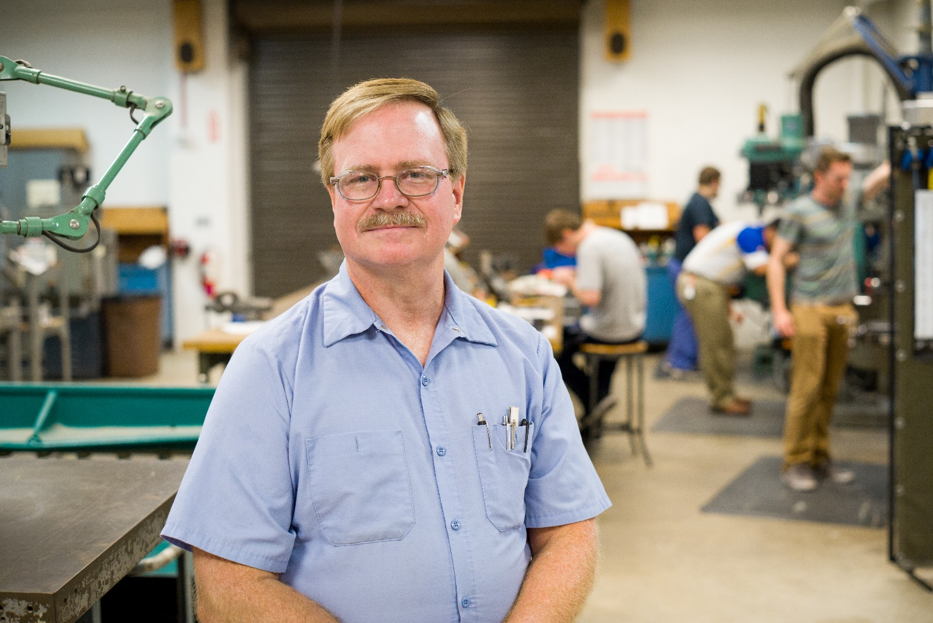
Mr. Scott Nelson
Machinist
Engineering Student Machine Shop
University of Delaware

Slide 2
Biography
I have been interested in How things work my whole life.
My favorite classes in school were Metal shop, Wood shop, and electrical shop.
I graduated from Delcastle Technical High School in Wilmington, Delaware with an Electronics major.
I found automobiles fascinating, so I attended Automotive Training Center in Exton, Pa. graduating as an Automotive Machinist.
After working as an Automotive Machinist/Engine Rebuilder for several years, I went to college and received a degree in Automotive Technology.
I worked as an Automobile Technician and business owner for many years.

Slide 3
Biography page 2
I started working in a Conventional Machine shop in the early 90’s.
My previous job was at ATK in Elkton, Md. Where I machined rocket engine, missile defense, and other aerospace parts to very tight tolerances using manual and CNC machines.
I have been fascinated with rockets and space for many years, and it was very interesting to manufacture these parts.
I came to the University of Delaware in 2014, and currently enjoy passing on my knowledge and experience to the next generation.

